Slide 1
Image Enhancement
Lecture-5

Slide 2
Last lecture
Histogram processing
Histogram specification/matching/modification

Slide 3

Histogram matching
Input histogram
$${p_{r}(r}_{k})= \frac{n_{k}}{n}$$
Target histogram ${p_{z}(z}_{k})$
$$T\left(r_{k}\right)=\sum_{i=0}^{k}{p_{r}\left(r_{i}\right)}=s_{k}$$
$$v_{k}=G\left(z_{k}\right)=\sum_{i=0}^{k}{p_{z}\left(z_{i}\right)}=s_{k}$$
Transformation matrices
$$z_{k}=\min{value of z for which G\left(z\right)−s≥0}$$

Slide 4
R (input intensity values) | Pr(r) (histogram) | T(r) = s | Pz(z) | G(z) | Z’ (output intensity)
0
1
2
3
4
5
6
7

Slide 5
R (input intensity values) | Pr(r) (histogram) | T(r) = s | Z | Pz(z) | G(z) | Z’ (output intensity)
0 | 0 | 0 | 0 | 0 | 0 | 0
1 | 0.1 | 0.1 | 1 | 0.1 | 0.1 | 1
2 | 0.1 | 0.2 | 2 | 0.2 | 0.3 | 2
3 | 0.3 | 0.5 | 3 | 0.4 | 0.7
4 | 0 | 0.5 | 4 | 0.2 | 0.9
5 | 0 | 0.5 | 5 | 0.1 | 1
6 | 0.4 | 0.9 | 6 | 0 | 1
7 | 0.1 | 1 | 7 | 0 | 1

Slide 6
R (input intensity values) | Pr(r) (histogram) | T(r) = s | Z | Pz(z) | G(z) | Z’ (output intensity)
0 | 0 | 0 | 0 | 0 | 0 | 0
1 | 0.1 | 0.1 | 1 | 0.1 | 0.1 | 1
2 | 0.1 | 0.2 | 2 | 0.2 | 0.3 | 2
3 | 0.3 | 0.5 | 3 | 0.4 | 0.7 | 3
4 | 0 | 0.5 | 4 | 0.2 | 0.9 | 3
5 | 0 | 0.5 | 5 | 0.1 | 1 | 3
6 | 0.4 | 0.9 | 6 | 0 | 1 | 4
7 | 0.1 | 1 | 7 | 0 | 1 | 5

Slide 7
Today’s lecture
Mask processing techniques
Linear smoothing filter (averaging)
Median filter (nonlinear)
Sharpening filter

Slide 8
The Spatial Filtering Process
Origin
x
a
b
c
j
k
l
d
e
f
*
m
n
o
g
h
i
p
q
r
Original Image Pixels
Filter (w)
Simple 3*3 Neighbourhood
e
3*3 Filter
e_{processed} = n*e + j*a + k*b + l*c
+ m*d + o*f + p*g
+ q*h + r*i
y
Image f (x, y)

Slide 10

Smoothing Spatial Filters
1. Simple averaging filter
Simply average all of the pixels in a neighbourhood around a central value.
Useful in removing noise from images.
1 | 1 | 1
1 | 1 | 1
1 | 1 | 1
¹/₉
¹/₉
¹/₉
$$\frac{1}{9}×$$
¹/₉
¹/₉
¹/₉
¹/₉
¹/₉
¹/₉

Slide 11
104
100
108
¹/₉
¹/₉
¹/₉
99
106
98
*
¹/₉
¹/₉
¹/₉
95
90
85
¹/₉
¹/₉
¹/₉
Original Image Pixels
Filter
e = ¹/₉*106 + ¹/₉*104 + ¹/₉*100 + ¹/₉*108 + ¹/₉*99 + ¹/₉*98 + ¹/₉*95 + ¹/₉*90 + ¹/₉*85
= 98.3333

Slide 12
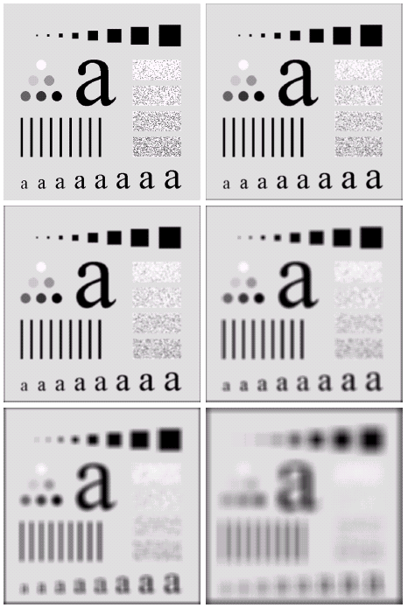
Image Smoothing Example
The image at the top left is an original image of size 500*500 pixels.
The subsequent images show the image after filtering with an averaging filter of increasing sizes
→ 3, 5, 9, 15 and 35

Slide 13
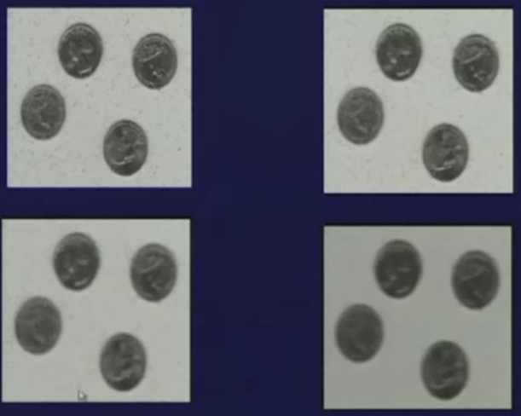

Slide 14
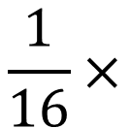
2. Weighted averaging filter
Averaging filter disadvantage:
Noise is removed but has high blurring effect.
To avoid high blurring effect in simple averaging filter
1 | 2 | 1
2 | 4 | 2
1 | 2 | 1
¹/₁₆ | ²/₁₆ | ¹/₁₆
²/₁₆ | ⁴/₁₆ | ²/₁₆
¹/₁₆ | ²/₁₆ | ¹/₁₆
$$\frac{1}{16}×$$

Slide 15
In case of weighted averaging filter, the blurring effect reduces compared to the averaging filter.

Slide 16
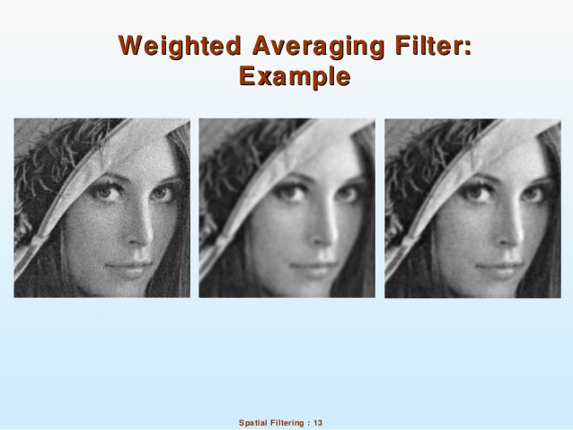

Slide 17
Non-Linear Smoothing Filters
Median filter
Based on statistics
Ascending order:
104
100
108
85
90
95
98
99
100
104
106
108
99
106
98
99
95
90
85
Original Image Pixels
Processed Image Pixels

Slide 18
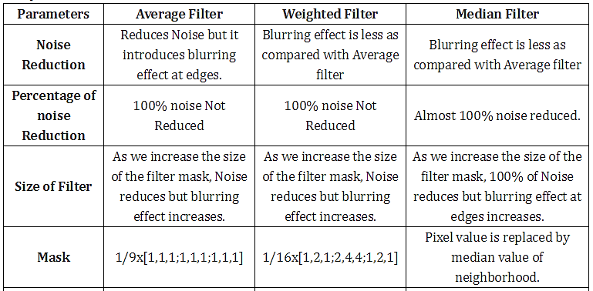

Slide 19
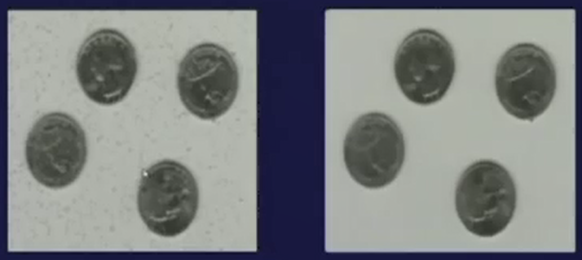
Averaging Filter Vs. Median Filter
Example
Image After Averaging Filter
3 X 3
Image After Median Filter

Slide 20
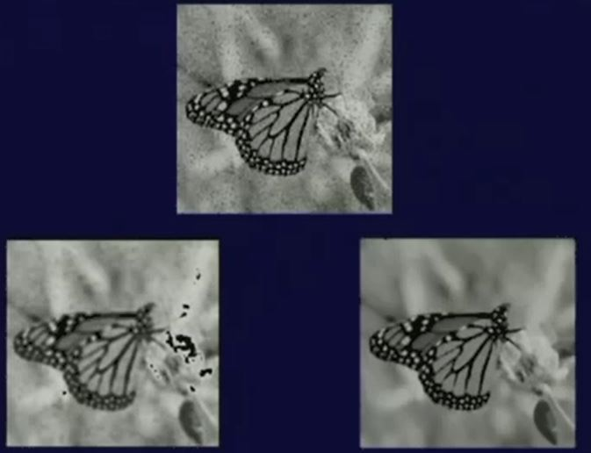
5 X 5

Slide 21
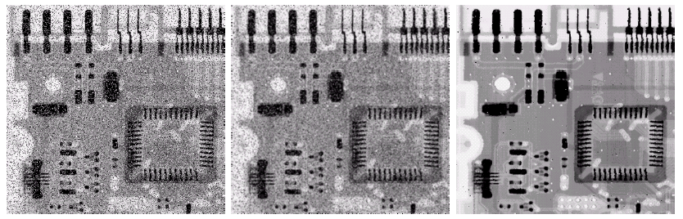
Averaging Filter Vs. Median Filter
Example
Original Image With Noise
Image After Averaging Filter
Image After Median Filter
Sharpness/ edges are blurred in averaging filter but in case of median filter, edges are less blurred.
In median filter, noise removal can be achieved with less mask size.

Slide 22
Sharpening spatial filter
The principal objective of sharpening is to highlight fine detail in an image or to enhance detail that has been blurred, either in error or as an natural effect of a particular method of image acquisition.

Slide 23
First order derivative filter
Second order derivative filter

Slide 24
First order derivative filter
The formula for the 1st order derivative of a function f(x) is :
It is the difference between subsequent pixel values and measures the rate of change of the function

Slide 25
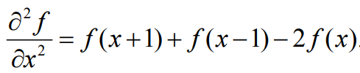
Second order derivative filter
The formula for the 2nd derivative of a function is as follows:
Simply takes into account the values both before and after the current value

Slide 26
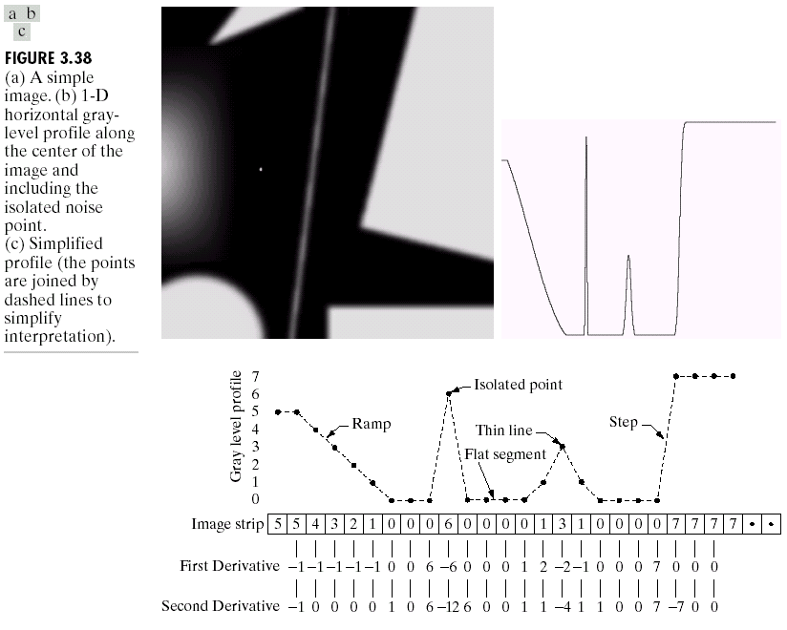
Example

Slide 27
A
B

Slide 28
Isolated point
Ramp
Step
Thin line
Flat segment
5 | 5 | 4 | 3 | 2 | 1 | 0 | 0 | 0 | 6 | 0 | 0 | 0 | 0 | 1 | 3 | 1 | 0 | 0 | 0 | 0 | 7 | 7 | 7 | 7
 | -1 | -1 | -1 | -1 | -1 | 0 | 0 | 6 | -6 | 0 | 0 | 0 | 1 | 2 | -2 | -1 | 0 | 0 | 0 | 7 | 0 | 0 | 0
0
 | -1 | 0 | 0 | 0 | 0 | 1 | 0 | 6 | -12 | 6 | 0 | 0 | 1 | 1 | -4 | 1 | 1 | 0 | 0 | 7 | -7 | 0 | 0

Slide 29
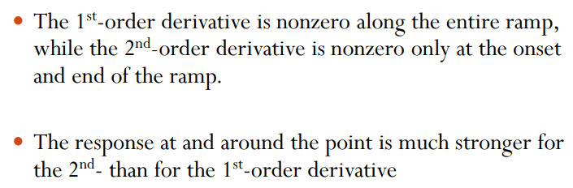

Slide 30
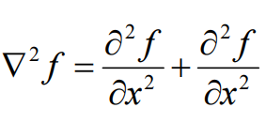
Laplacian filter (2nd order derivative)
The Laplacian is defined as follows:
where the partial 1st order derivative in the x direction is defined as follows:
and in the y direction as follows:

Slide 31
So, the Laplacian can be given as follows:
We can easily build a filter based on this
0
1
0
1
-4
1
0
1
0

Slide 32
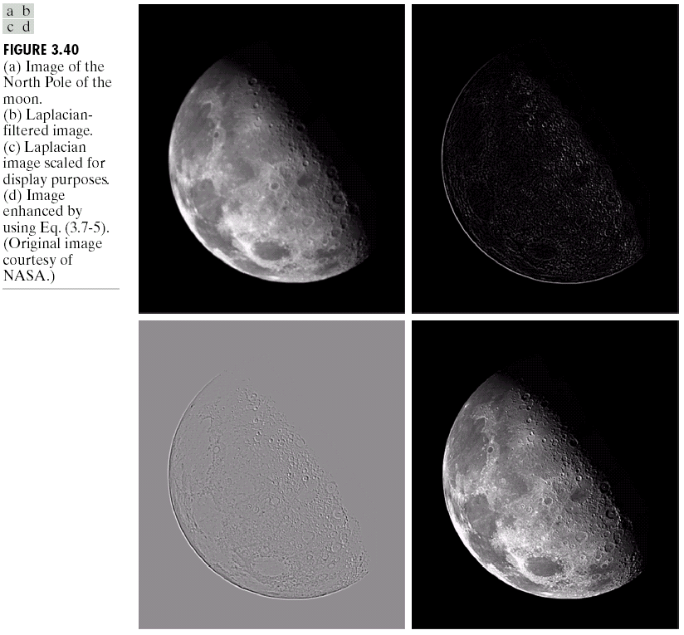
Applying the Laplacian to an image we get a new image that highlights edges and other discontinuities.
Original Image
Laplacian Filtered Image

Slide 33
Subtract the Laplacian result from the original image to generate our final sharpened enhanced image
-
=
Original Image
Laplacian Filtered Image
Sharpened Image

Slide 35
The entire enhancement can be combined into a single filtering operation
0
-1
0
-1
5
-1
0
-1
0

Slide 36




Unsharp Masking
Steps
Blur
Subtract from original image (unsharp mask)
add resulting mask to original image
$$f_{b}(x,y)$$
$$mask=f\left(x,y\right)−f_{b}(x,y)$$
$$f_{sharp}\left(x,y\right)=f\left(x,y\right)+mask$$
$$f_{sharp}\left(x,y\right)=2f\left(x,y\right)−f_{b}(x,y)$$

Slide 38
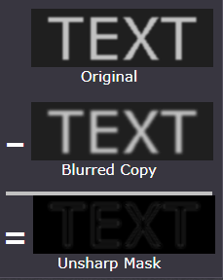
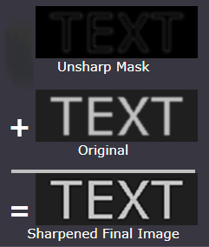

Slide 39


High boost filtering
$$f_{hb}\left(x,y\right)=\left(A+1\right)f\left(x,y\right)−f_{b}\left(x,y\right), A≥1$$
$$=\left(A−1\right)f\left(x,y\right)+2f(x,y)−f_{b}\left(x,y\right)$$
$$=\left(A−1\right)f\left(x,y\right)+f_{sharp}\left(x,y\right)$$
Laplacian
$$=Af\left(x,y\right)−f(x,y)+f_{sharp}\left(x,y\right)$$
$$=Af\left(x,y\right)−∇^{2}f(x,y)$$
What is the mask for this????

Slide 40
0
-1
0
-1
A+4
-1
0
-1
0

Slide 41
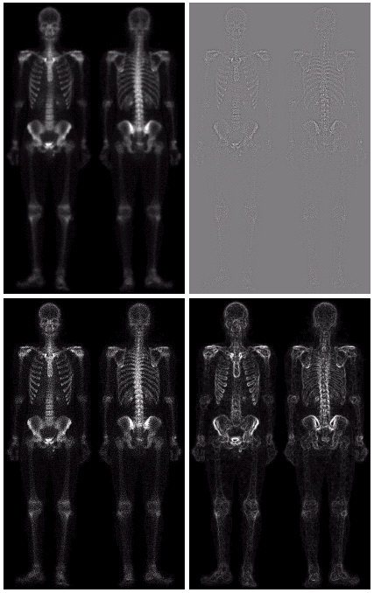
Combining Spatial Enhancement Methods
Successful image enhancement is typically not achieved using a single operation
Rather we combine a range of techniques in order to achieve a final result

Slide 42
(a)
Laplacian filter of bone scan (a)
(b)
Sharpened version of bone scan achieved by subtracting (a) and (b)
(c)
1st derivative
(d)

Slide 43
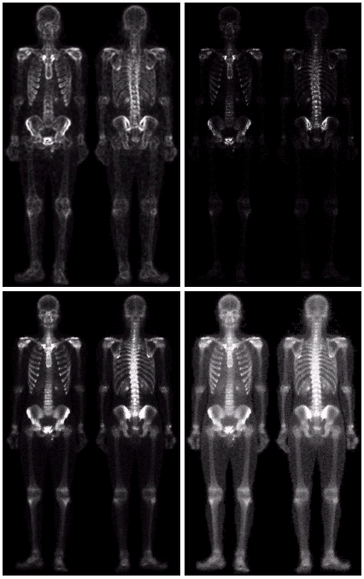
Result of applying a power-law trans. to (g)
(h)
Sharpened image which is sum of (a) and (f)
(g)
The product of (c) and (e) which will be used as a mask
(f)
(e)
Image (d) smoothed with a 5*5 averaging filter

Slide 44
Matlab task: To obtain the output image using the techniques explained in previous slides.

Slide 45
Assignment
Which is more preferred for smoothening the image - averaging filter or median filter? Explain the reason.
Explain first order derivative and second order derivative filter. Which is more preferred and why?
Why Laplacian operator is normally used for image sharpening operations?
What is unsharp masking?
How is the mask for high boost filtering achieved?

